Slide 1
Coffee Vending Machines in School
MERCADO Rainer Maalik• DURANTE Lorenz

Slide 2
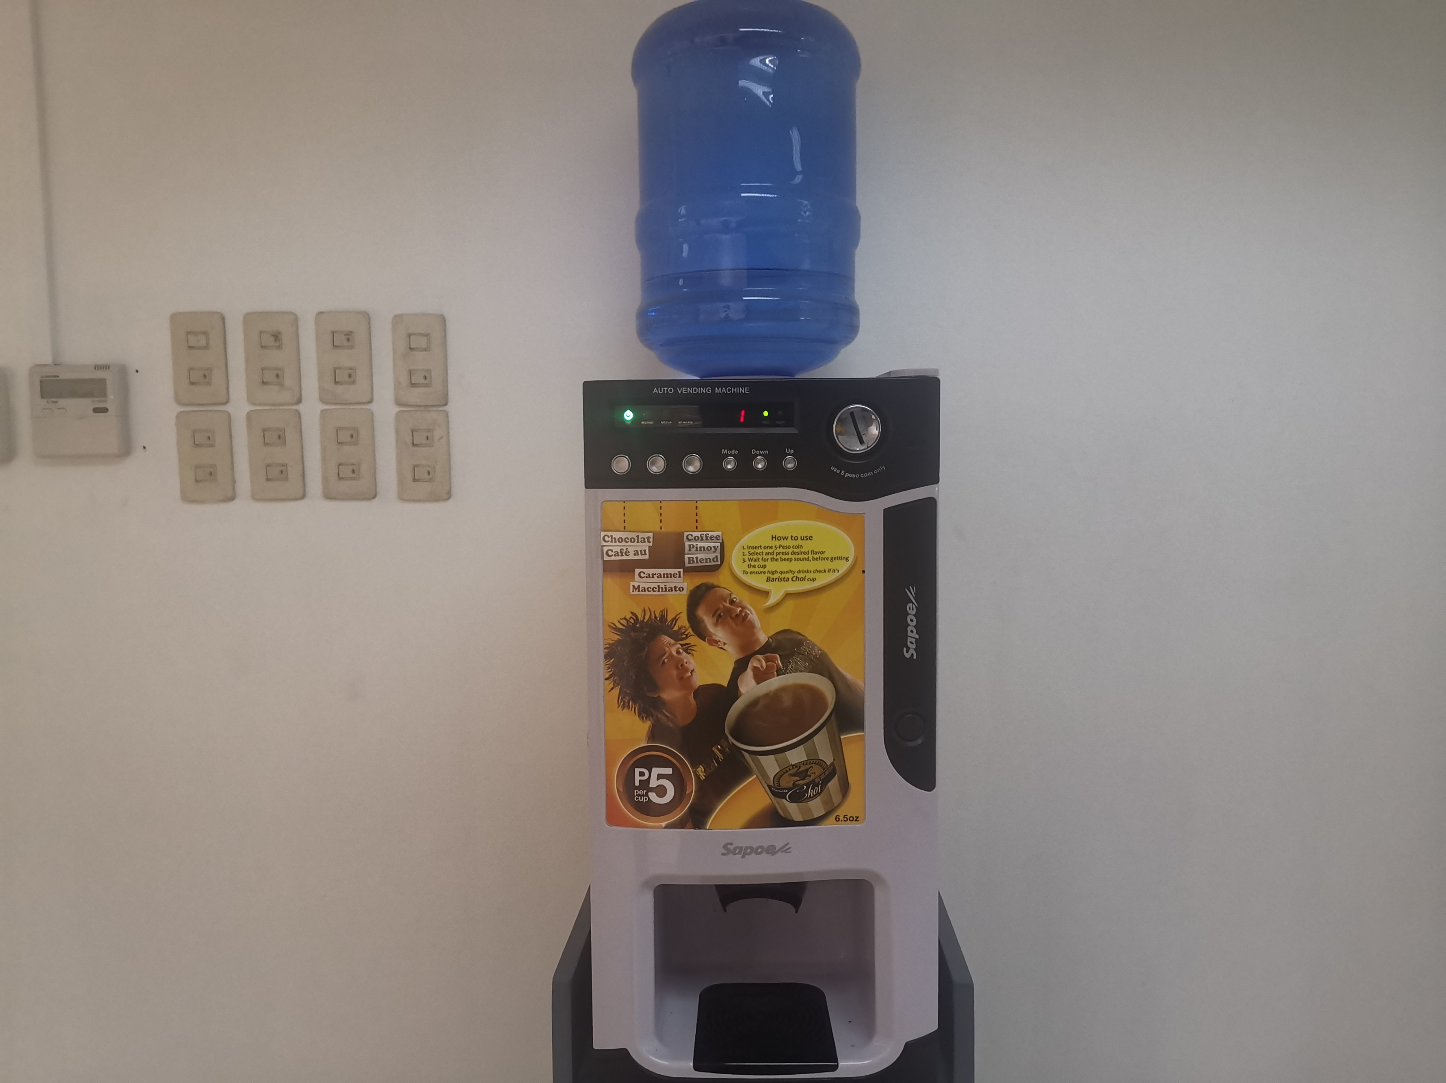
OBSERVATION
Few options

Slide 3
OBSERVATION
Few options

Slide 4
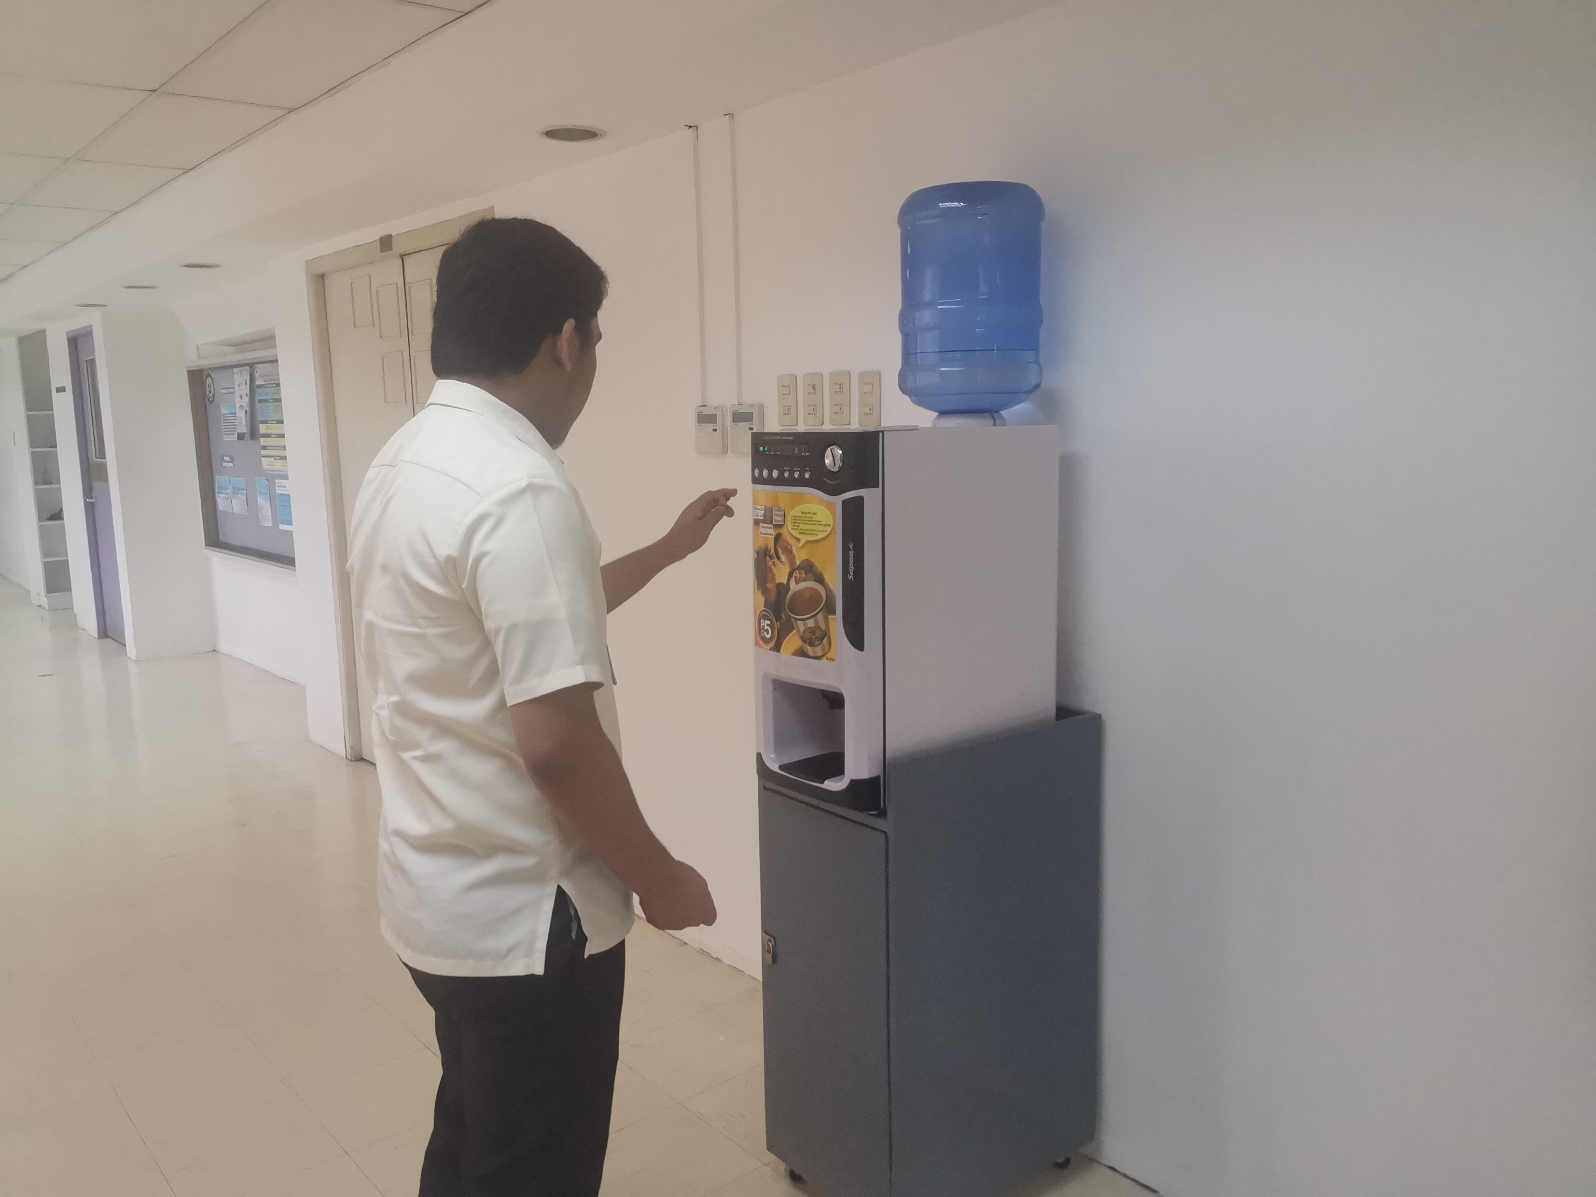


Slide 5
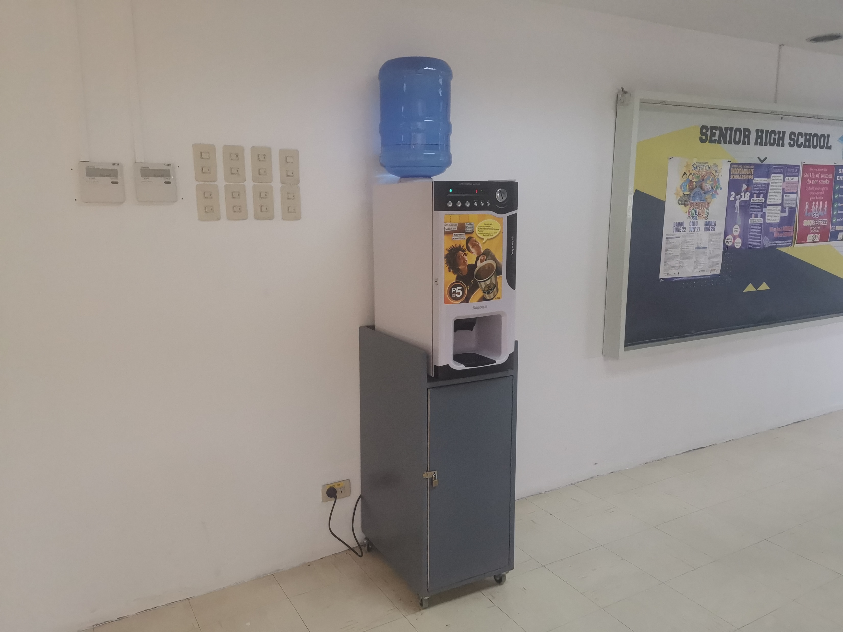
OBSERVATION
Limited use of features

Slide 6
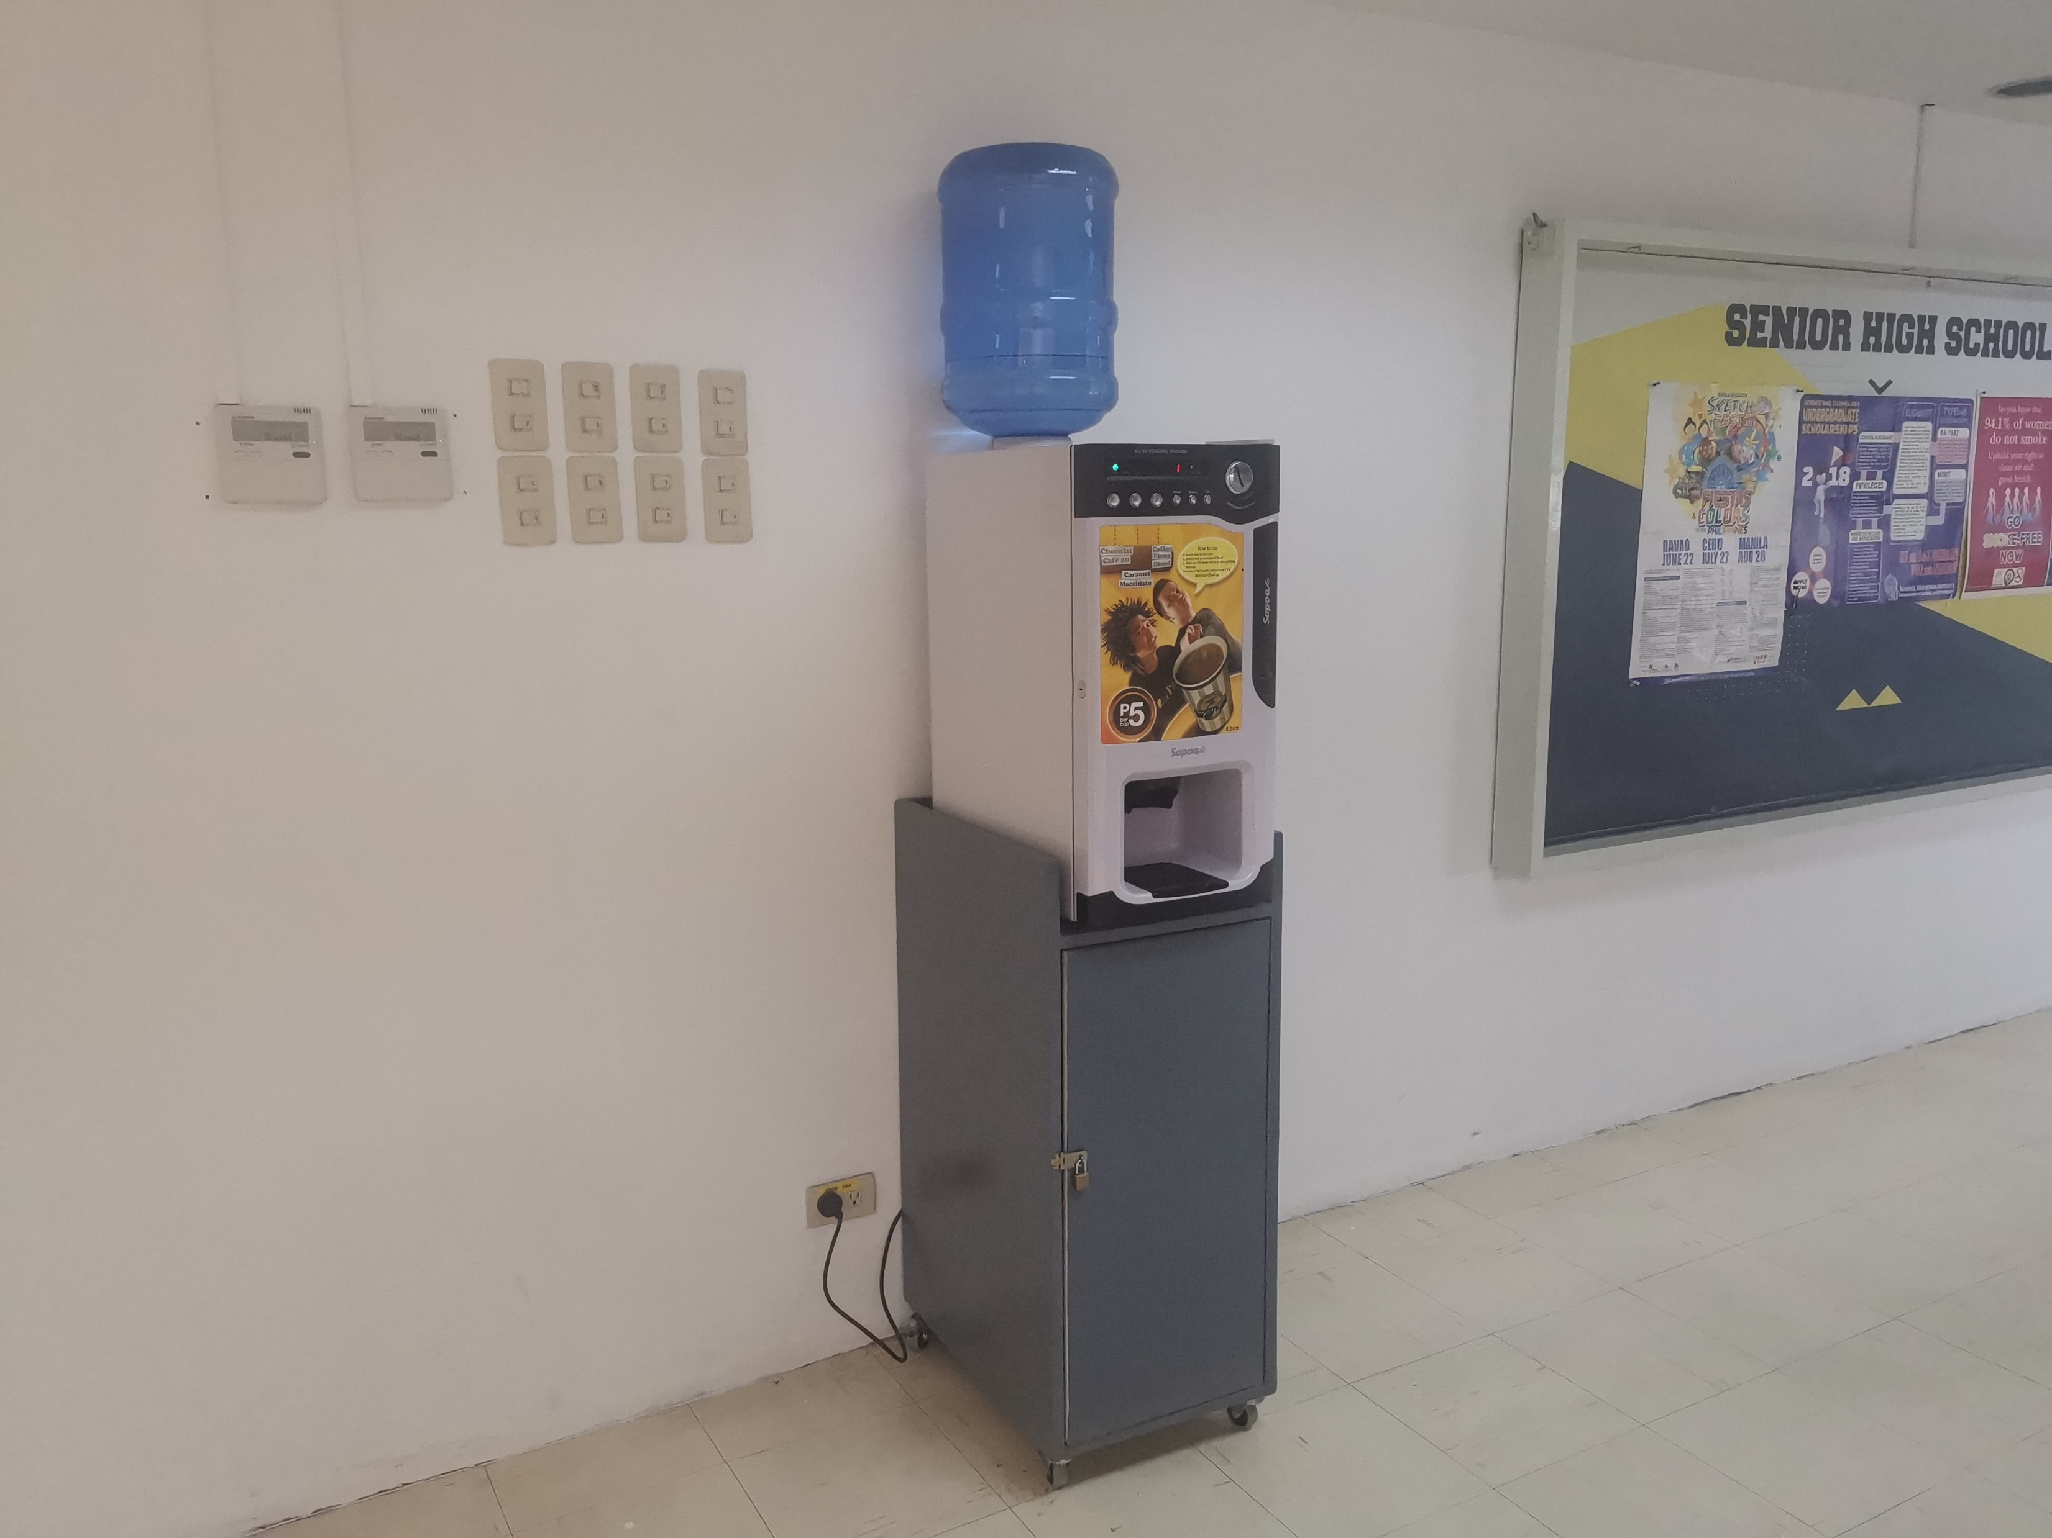
OBSERVATION
Limited use of features

Slide 7
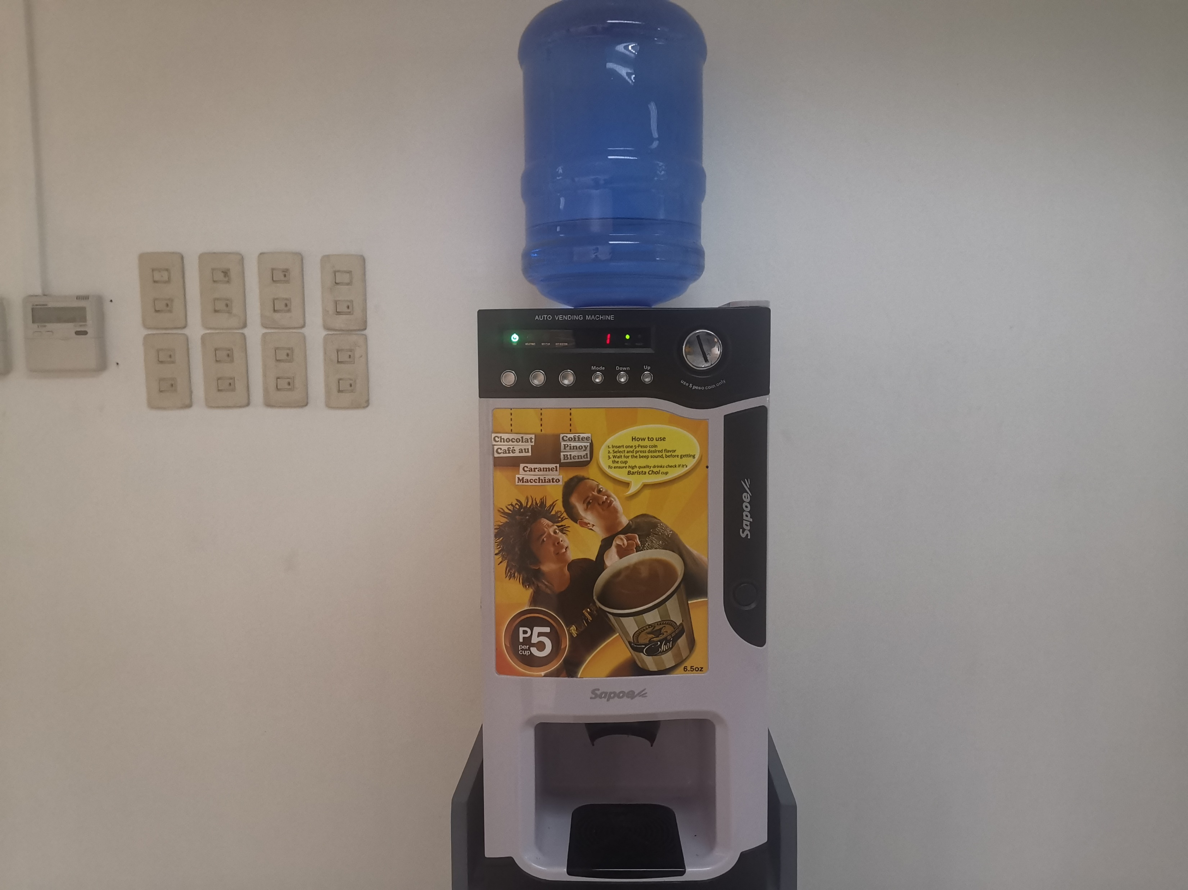
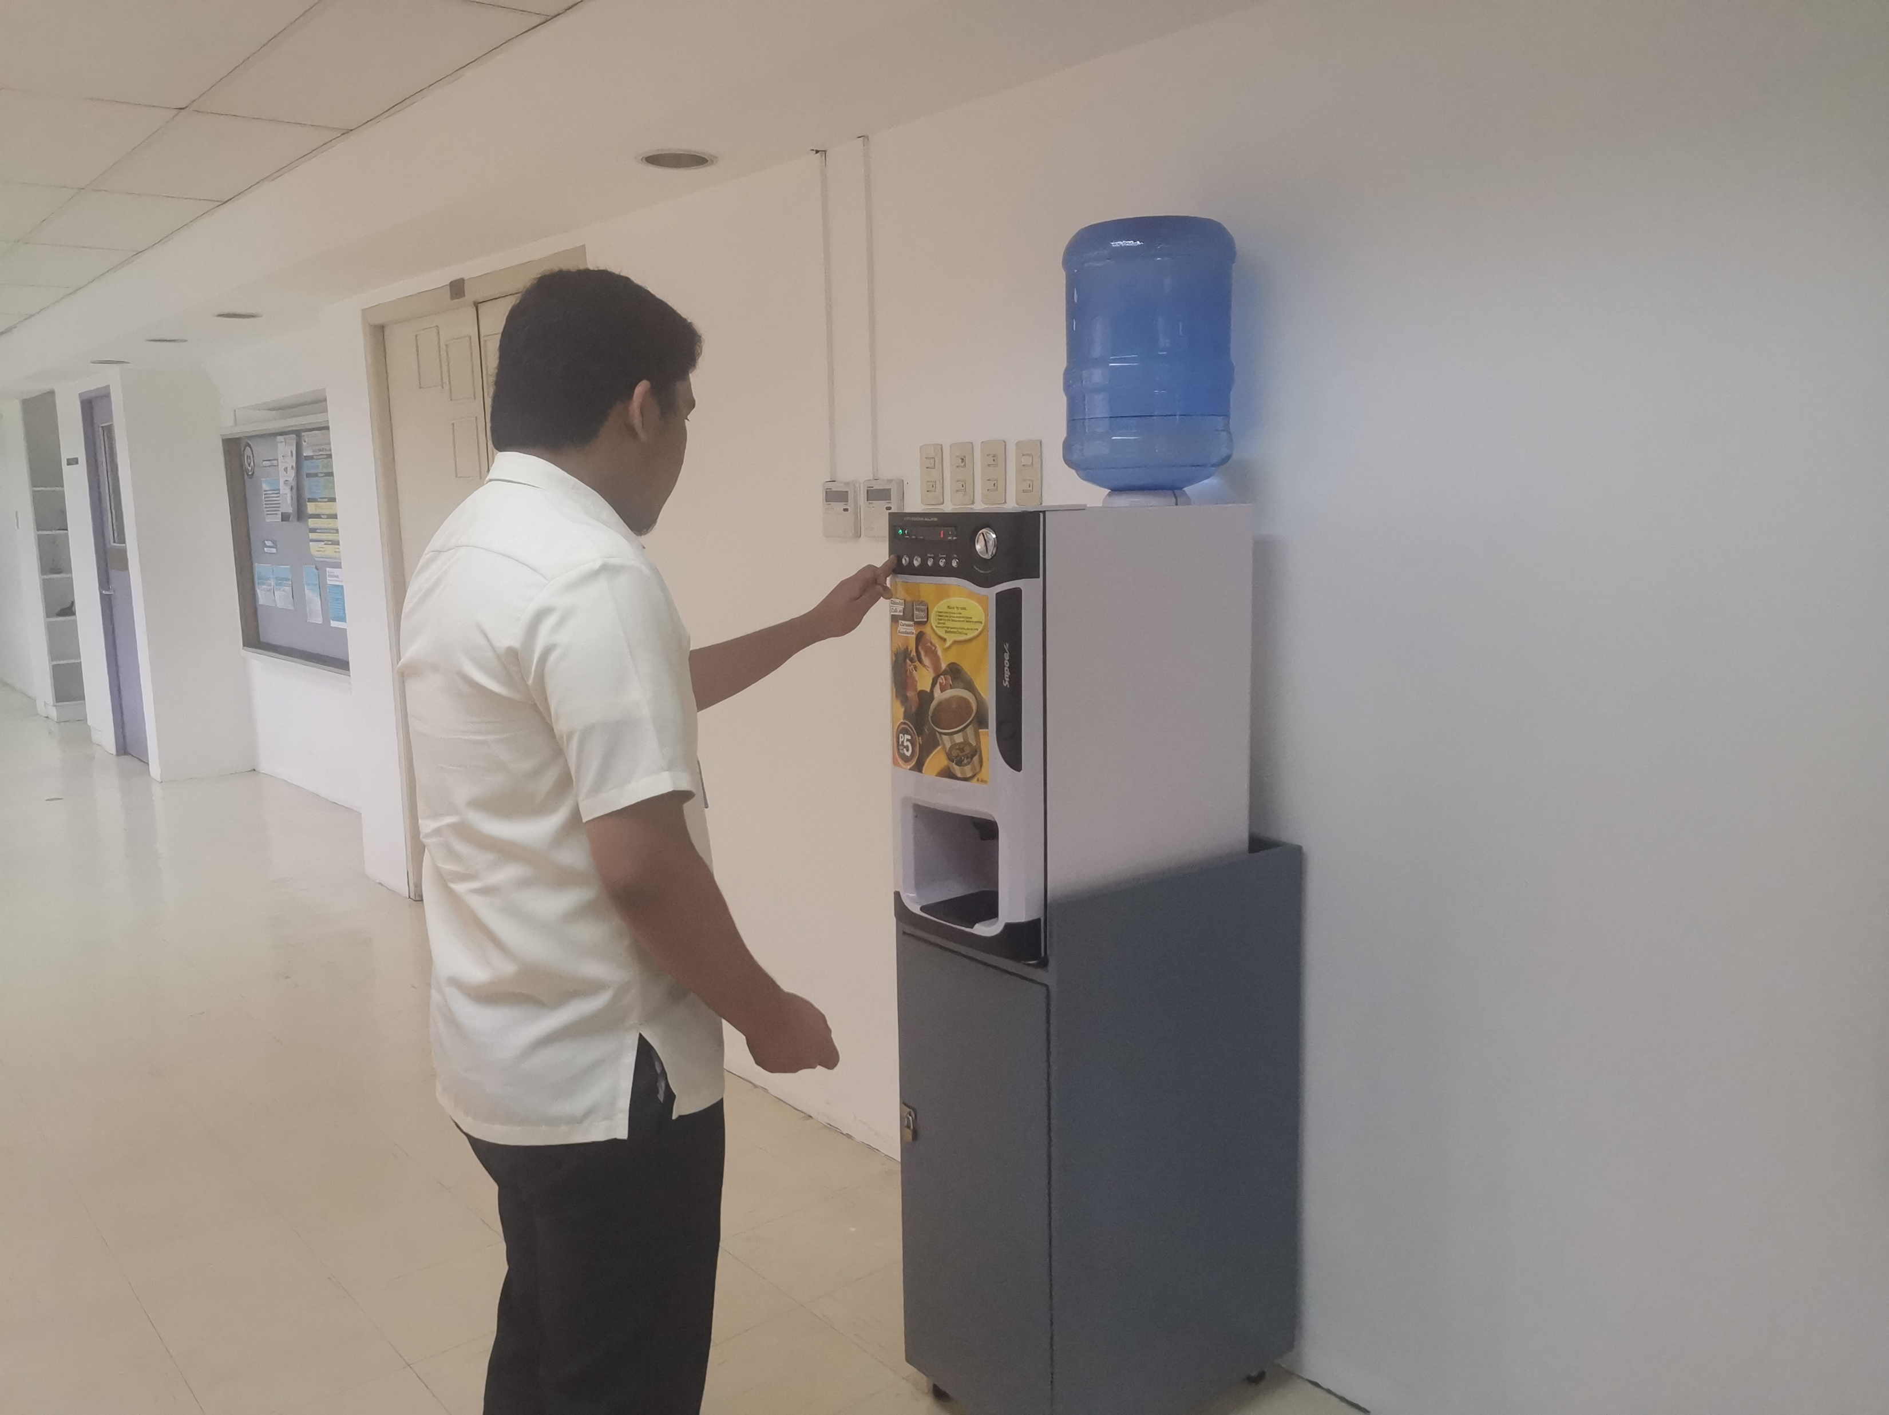
OBSERVATION
Lack of Accessible Coffee Vending Machines

Slide 8
OBSERVATION
Lack of Accessible Coffee Vending Machines

Slide 9
Identified Needs
The APC Community, most especially students, now need to have a better way to access caffeinated drinks.
Students need a quick way for payment process.
Students need a wider variety of options for drinks.
Students need better features for the current one can improve on efficiency.
Students need an alternative way for payment process.

Slide 10
Points of View
FEW OPTIONS
Students want more choices instead of having just coffee for the offered drinks.
Not all students would drink coffee, some would just need a warm drink non-caffeinated.

Slide 11
Points of View
LIMITED USE OF FEATURES
The process of payment is very old-school. There’s a need for modernization and better efficiency.
The process of getting a drink is quite stale and now there is a need for using modern features.

Slide 12
Points of View
LACK OF ACCESSIBLE COFFEE VENDING MACHINES
Students need to have a better way of accessing a coffee machine, for a coffee machine is only located at certain floors inside the school.
Coffee vending machines should be dispersed around different floors for better convenience.

Slide 13
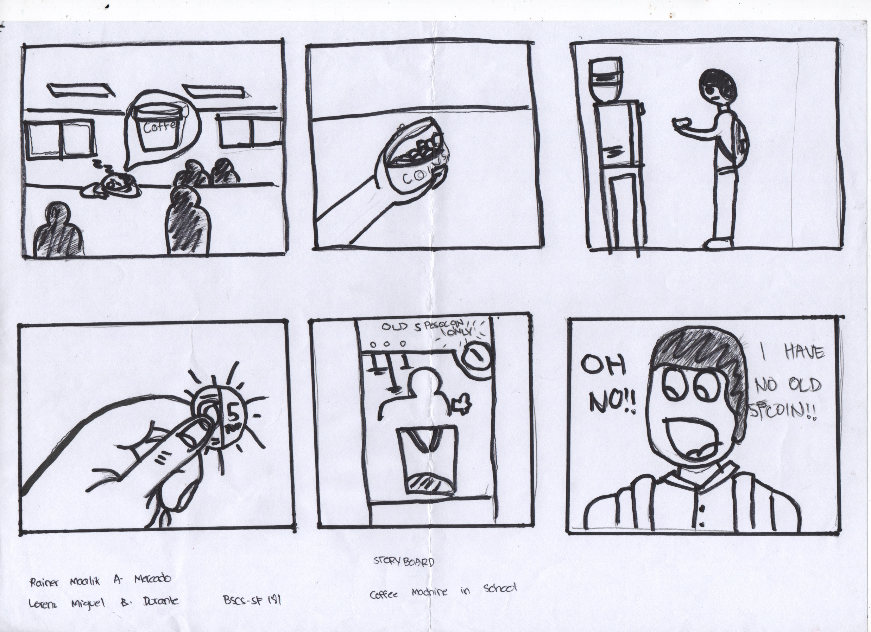

Slide 14
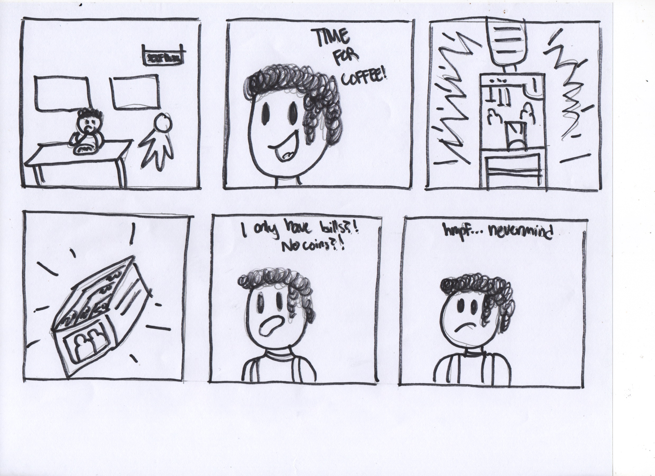

Slide 15
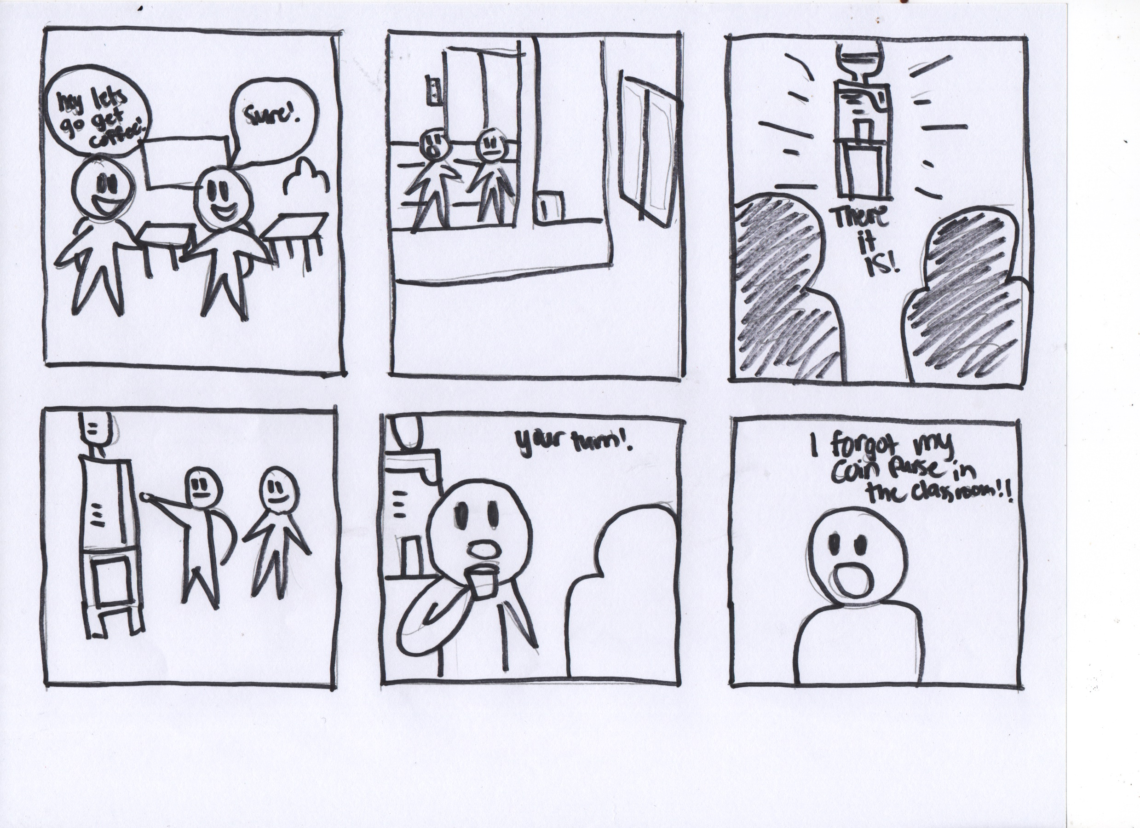

Slide 16


